Slide 1



Predicting Solar Energy Production
By: sivagami p

Slide 2
objective
Goal: Predict annual solar energy production (kWh) for new projects.
Streamlined Project Planning: The model will estimate annual energy output for future solar projects, resulting in more accurate financial models, improved project feasibility assessments, and faster project development cycles.
Use-case: Help customers choose best developer, equipment, and region to maximize Return on investment.
Target Variable: Estimated Annual PV Energy Production (kWh)

Slide 3
2. Data Understanding
Size: ~218k rows × 17 columns.
Key Inputs:
Project details: Project ID, Interconnection Date, Developer, Utility, Metering Method.
Location: City/Town, County, Zip, Division, Substation, Circuit ID.
System Specs: Estimated PV System Size (kWdc), PV System Size (kWac), Energy Storage Size.
Target: Estimated Annual PV Energy Production (kWh).

Slide 4
Understanding Data Issues:
Missing values (Division, Substation, Developer, Energy Storage almost empty).
Strong skew (small residential → huge utility projects).
Mixed categorical and numeric features.

Slide 5
Handling missing values
Dropped high missing columns(division,substation,energy storage system size(kwac))
Filled categorical columns with “unknown”(developer, metering method, city/town,country,utility)
Filled numeric values with median(zip) and mode(circuit ID, project ID)
Converted date columns to datetime format

Slide 6
Handling outliers
Checked for outliers
Removed outliers with IQR method

Slide 7
Feature engineering
Converted and Extracted Time Features(Older systems may degrade; newer installations might use better technology.)
Created Solar Efficiency Metrics
Performance Ratio / Yield(This shows how much energy (kWh) is produced per installed kW. Typical values: 800–1600 kWh/kW/year.) Capacity Factor( Capacity Factor represents the real-world utilization efficiency of the solar system (normally 10–25%).)
Log Transformation of Skewed Variables
Encoded Categorical Variables
Included system scale column- differentiate between residential and utility-scale systems.

Slide 8
Model Building
Train test split
Baseline modell- Linear Regression
Tuned model- Decision tree, Randon forest
Best model: Decision Tree[ R2-1.0 ][MAE-0.486255]

Slide 9
Insights:
System size is the strongest predictor.
Some developers consistently achieve higher yields.
Certain regions outperform others due to higher irradiance.

Slide 10
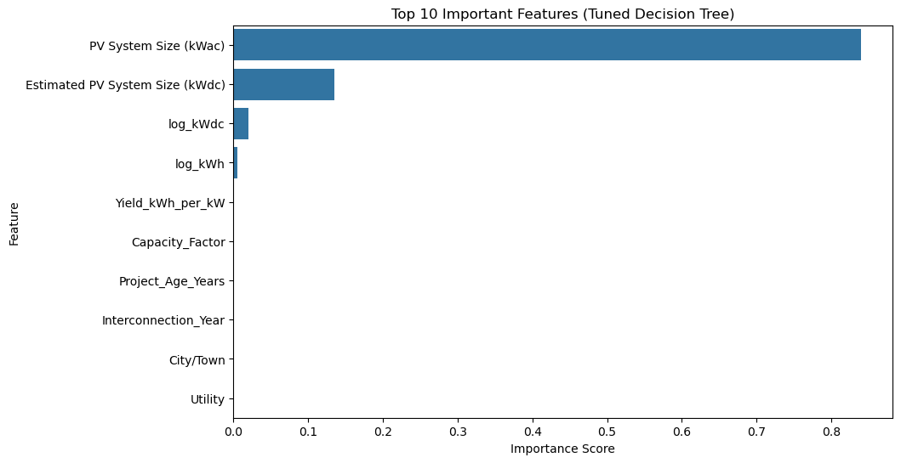

Slide 11
Deployment:
Interactive GRADIO Web App for real-time predictions.

Slide 12
THANKYOU

